Slide 1
Maven North Wind challenge practice Final
File created on: 24-12-2023 12:14:23

Slide 2
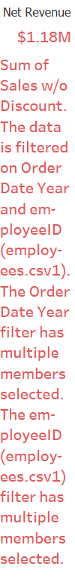

Slide 3
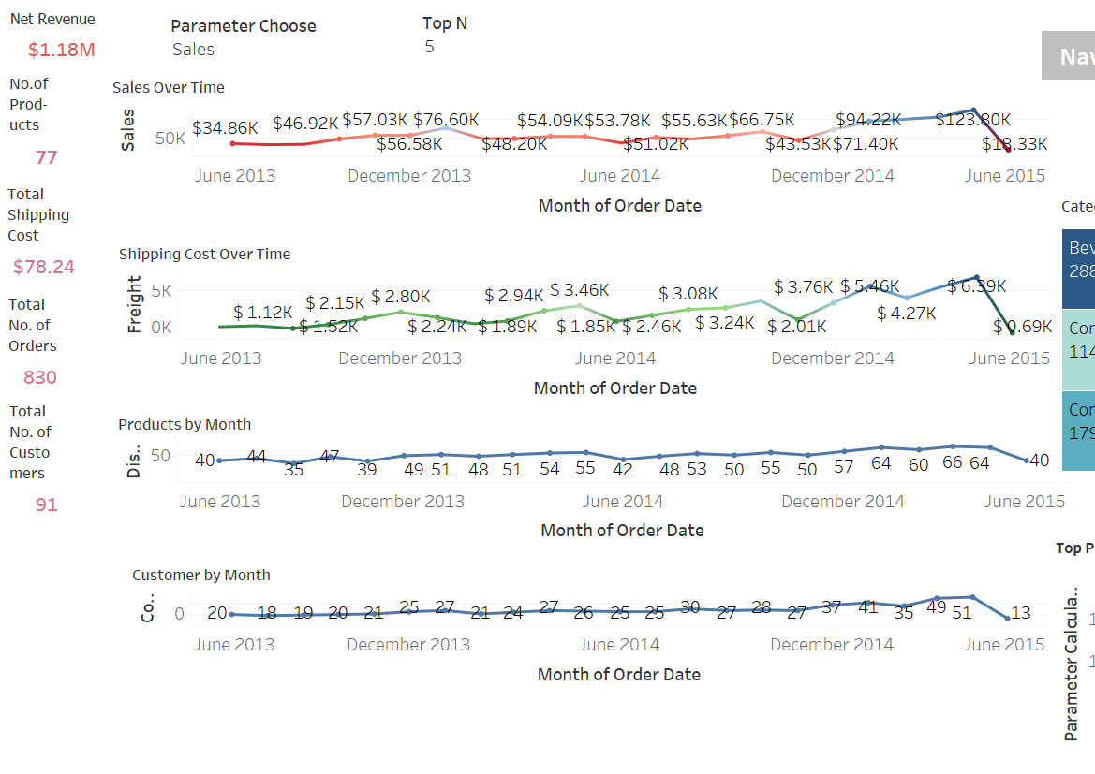

Slide 4
